Slide 1

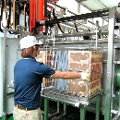
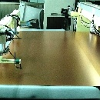
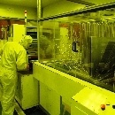

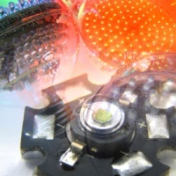

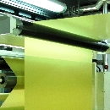
2025 Third Quarter Earnings Conference
Nov 12, 2025
Copyright © 2012 Taiwan Union Technology Corporation

Slide 2
Statements of Comprehensive Income
Total outstanding shares were 278,066 thousand units at 9/30/25
ROE figures are annualized based on average equity attributable to shareholders of the parent company.

Slide 3
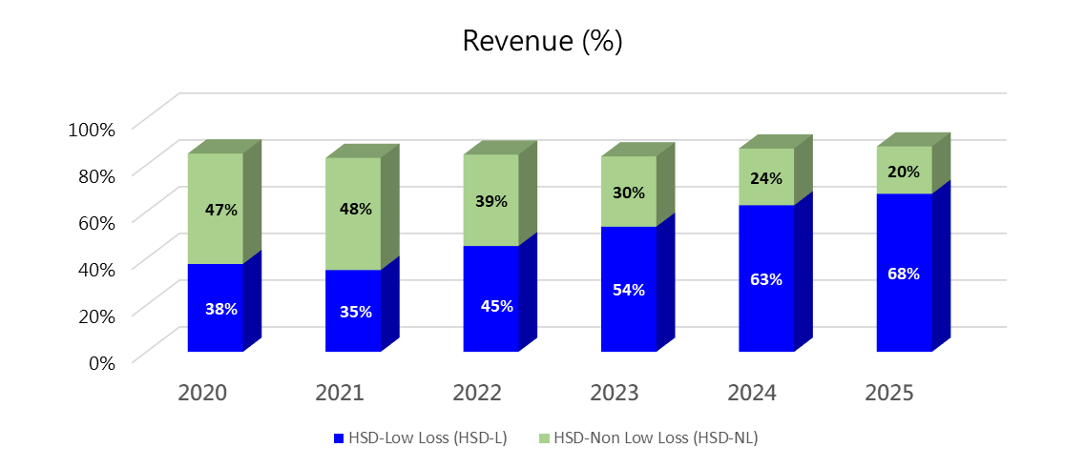
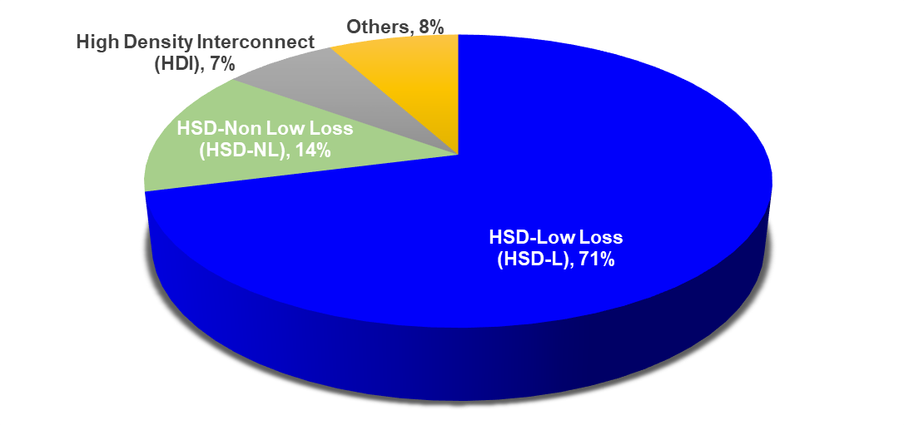
3Q25 CCL Revenue by Technology

Slide 4
Balance Sheets & Key Indices
Total outstanding shares were 278,066 thousand units at 9/30/25
Asset productivity = Annualized net revenue / Average net PP&E

Slide 5
Cash Flows
* Free cash flow = Cash from operating activities –Capital expenditures

Slide 6
https://www.tuc.com.tw
Ivon.Huang@tuc.com.tw
Copyright © 2012 Taiwan Union Technology Corporation

