Slide 1

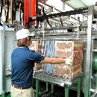
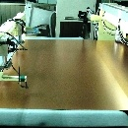
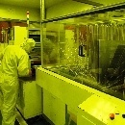

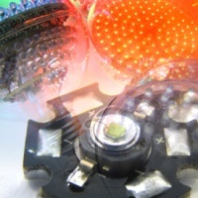

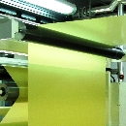
2026 Second Quarter Earnings Conference
July 29, 2026
Copyright © 2012 Taiwan Union Technology Corporation

Slide 2
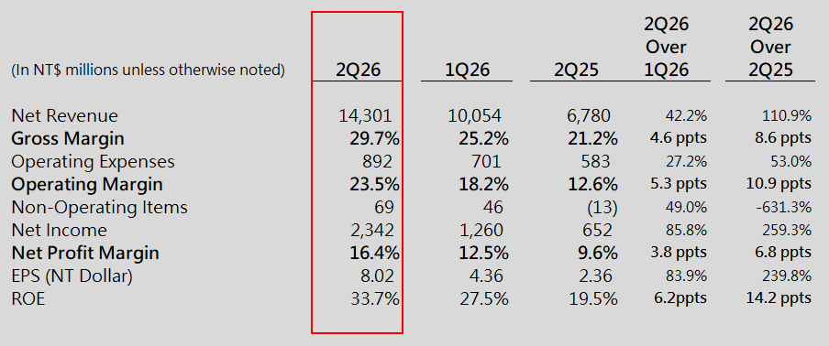
Statements of Comprehensive Income
Total outstanding shares were 290,463 thousand units at 6/30/26
ROE figures are annualized based on average equity attributable to shareholders of the parent company.

Slide 3
2Q26 CCL Revenue by Technology

Slide 4
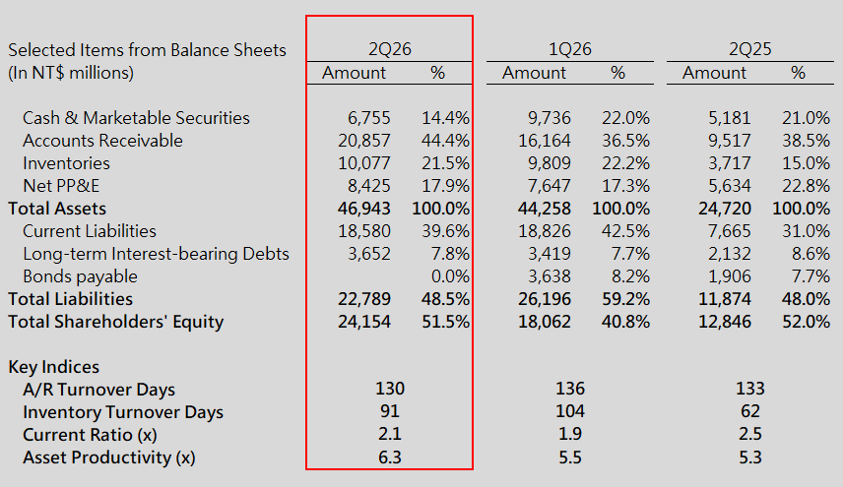
Balance Sheets & Key Indices
Total outstanding shares were 290,463 thousand units at 6/30/26
Asset productivity = Annualized net revenue / Average net PP&E

Slide 5
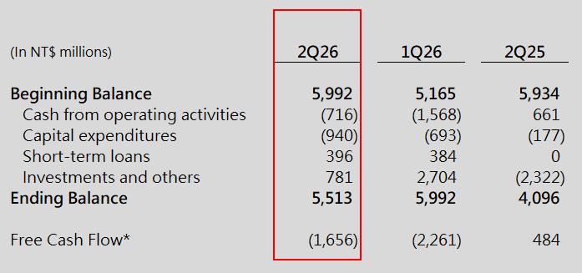
Cash Flows
* Free cash flow = Cash from operating activities –Capital expenditures

Slide 6
https://www.tuc.com.tw
Ivon.Huang@tuc.com.tw
Copyright © 2012 Taiwan Union Technology Corporation

